Slide 1
Automatic discovery of under-performing data slices in anomaly detection models
MLOps course Final Project
Nitay Cohen, Stav Cohen, Kilièmah Ouattara, Natalia Meergus

Slide 2
Contents
Business objective & target metrics
FreaAI - the theory behind the step
Architecture
Demo
The report
Suggested next steps

Slide 3
From business OBJECTIVE – to TECHNICAL metrics

Slide 4

Client background
Client: A water utility company
Business purpose: ensure uninterrupted supply of clean water to consumers
Major costs:
development and maintenance of water pipes infrastructure
fixes of infrastructure failures and repair of associated damage
Costs reduction:
by early failure detection
preventive measures and excessive checks

Slide 5
Client’s challenge
Strive to prevent all failures
proactively detect as much of the anomalies as possible
prioritize missed anomalies over false alarms
Achieve balanced anomalies detection independent of anomaly parameters

Slide 6
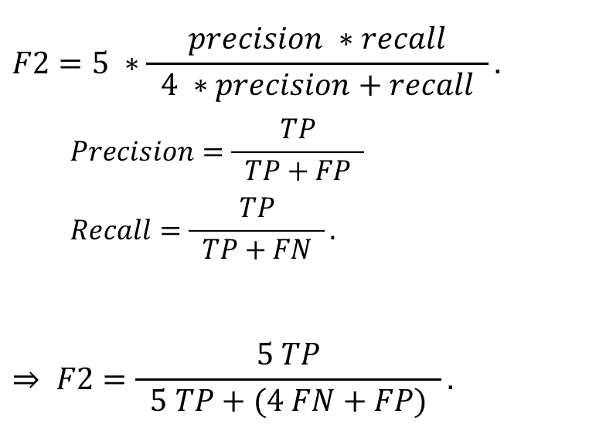
Project’s technical metric
F2:
weighted mean of precision and recall
giving more weight to recall than to precision
$$F2=5 ∗\frac{precision ∗recall}{ 4 ∗precision+recall }.$$
$$Precision=\frac{TP}{ TP+FP }$$
$$Recall=\frac{TP}{ TP+FN }.$$
$$⇒ F2=\frac{5 TP}{ 5 TP+(4 FN+FP) }.$$

Slide 7
Phase 1 of the project – technical goals
Measure F2 for variety of data slices.
Identify most under-performing data slices (in terms of F2).
Estimate overall F2 improvement expected as a result of performance improvement of a under-performing data slice.

Slide 8
Phase 1 technical metric
Potential F2 improvement of a data slice:
<F2 of rest of data slices> - <overall F2>
Phase 2 will focus on data slices with maximum potential F2 improvement, i.e. those which maximize overall F2 improvement.

Slide 9



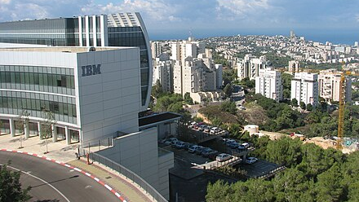

IBM FreaAI
“Automated extraction of data slices to test machine learning models”,
Aug 2021
Notes:
Preserving intuitivity

Slide 10
Method’s purpose
Identify data slices with low accuracy
Not talking about how to improve them

Slide 11
Decision Trees as a feature analysis heuristic
Input
X: single feature or subset of features of the original dataset
y: ‘True’ = original model correctly predicted the original output
‘False’ = original model failed in its prediction
Build the decision tree
Filter the leaves with:
minimal support (above 5% of total misclassification)
statistically significant drop in accuracy (above 4%)

Slide 12
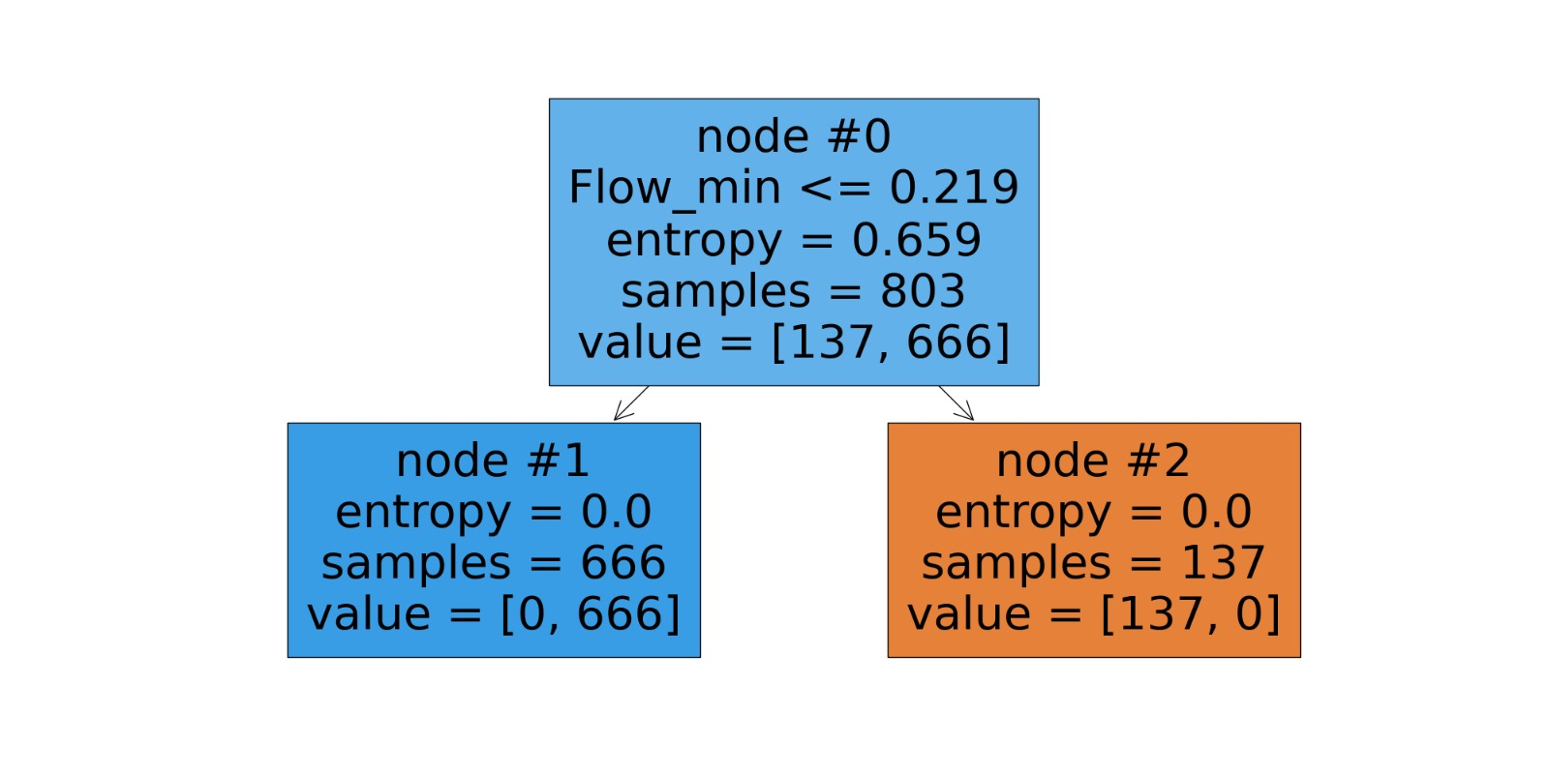
Decision tree – ideal case
True
False

Slide 13
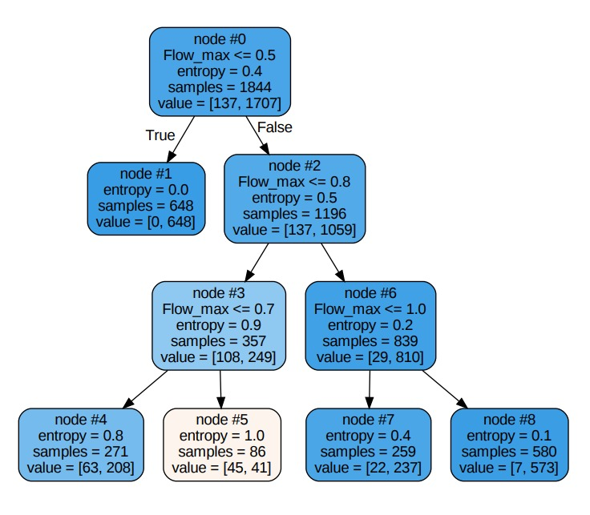
Decision tree – usual case

Slide 14

Our adaptation of FreaAI for anomalies detection
Notes:
Preserving intuitivity

Slide 15
FreaAI adaptation for F2 metric
Input:
X: single feature or subset of features in the original dataset, without TNs
Y: True’ = original model predicted the original output successfully = TP
‘False’ = original model failed in its prediction = FP + FN
Build the tree
Filter the nodes:
Number of samples below 20% of total
Sort the nodes by potential overall F2 improvement

Slide 16
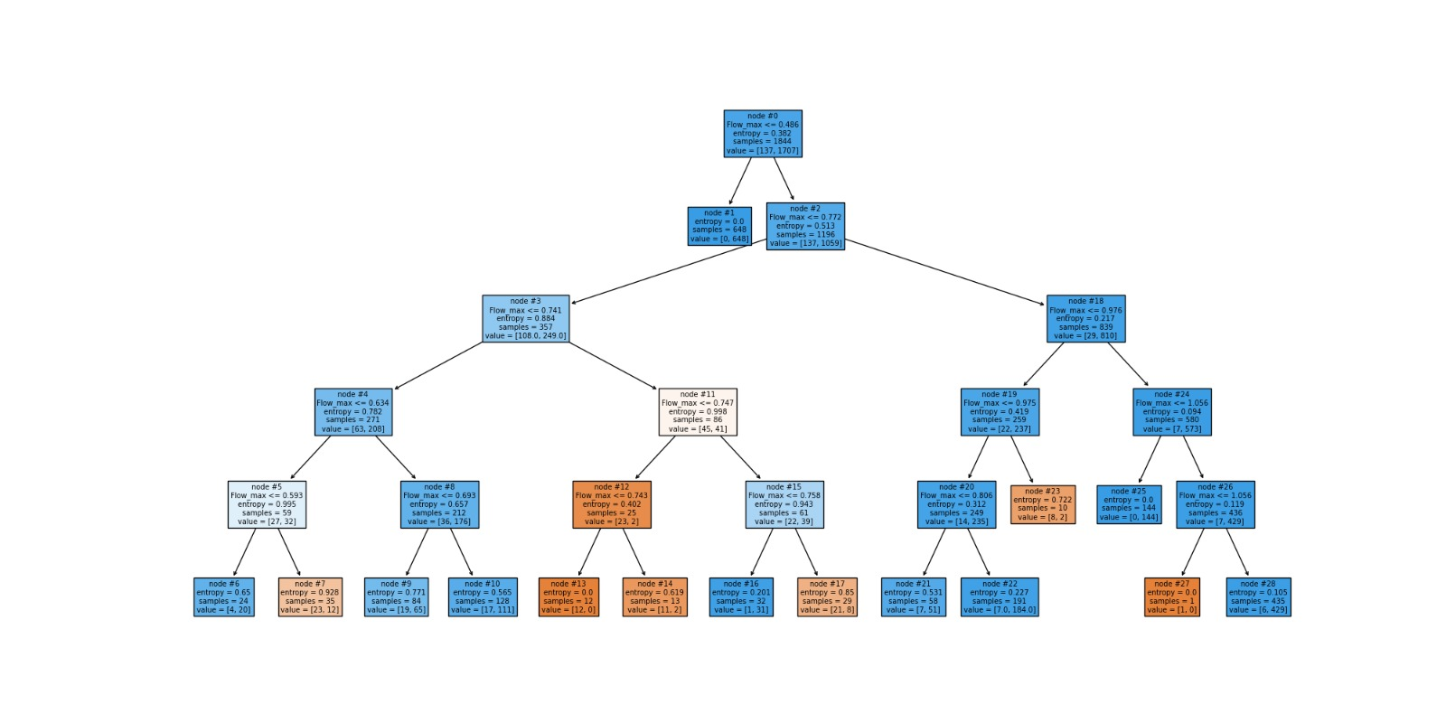
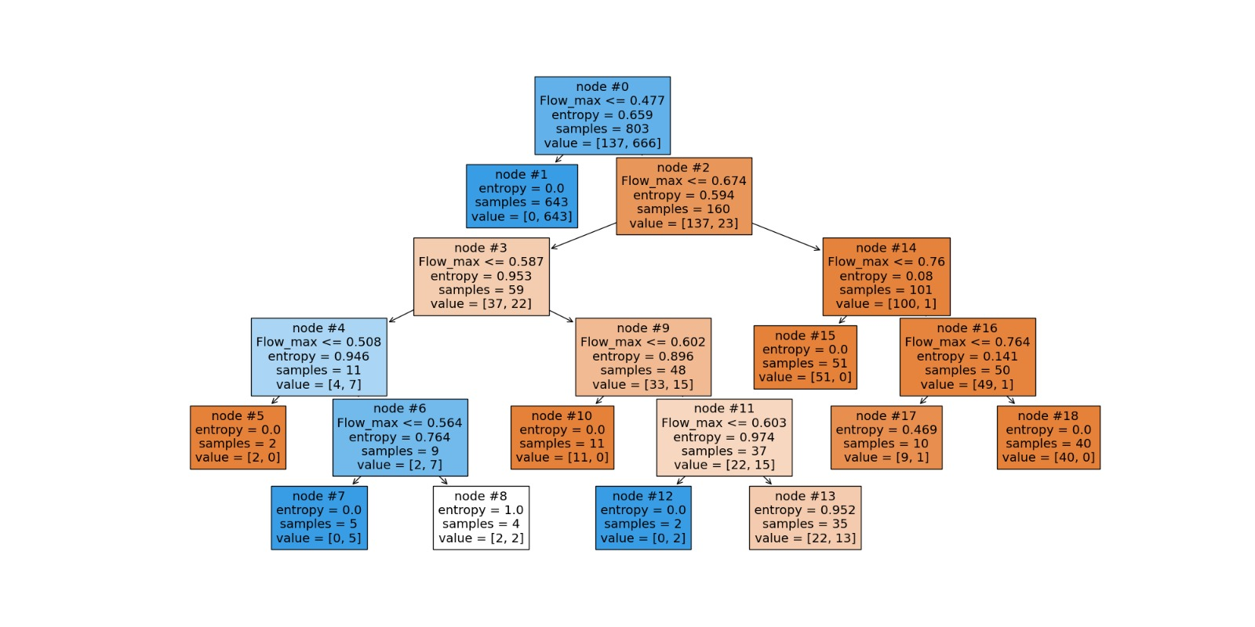

Comparison of approaches (decision-tree guiding metrics)
By accuracy:
$$F2=\frac{5 TP}{ 5 TP+(4 FN+FP) }$$
By F2:

Slide 17
The architecture

Slide 18
Architecture - Overall
Runtime environment: We use our laptops as the runtime environment, with the following installed:
OS: MacOS M1 / M2 or Windows 10+ supported
Python 3.11 with Anaconda / Miniconda installed
The requirements Python packages specified in requirements.txt files installed using pip or conda
In a real scenario the runtime environment should be run on an Instance in the cloud
Model registry: We use Databricks SaaS platform to register and store our trained models. The Databricks platform is hosted in AWS cloud

Slide 19
Architecture - Process
Load the dataset from a set of CSV files and concatinate them into a Dataframe object
By the selected algorithm (LightGBM / ConvAE):
Split the dataset into train / validation / test sets
Run a training using the train set and validate it with the valid set
Make a test using the test set in order to calculate our desired metrics
Run a FreaAI algorithm based on a single feature of the original dataset and compare between the predicted vs actual test results (In our use-case it’s anomaly)
Calculate our desired metrics based on the FreaAI algorithm
Register our model into Databricks platform
Load the model from Databricks and make a test using the test set in order to calculate our desired metrics

Slide 20
Architecture – MLFlow
MLFlow is a MLOps library provider by Databricks, a MLOps software company
We use MLFlow to register our trained model in the Databricks cloud SaaS platform
Using MLFlow, we can handle versions of the trained model
In production scenario, we can load the model from the platform and run a prediction against a test set in order to calculate our metrics

Slide 21
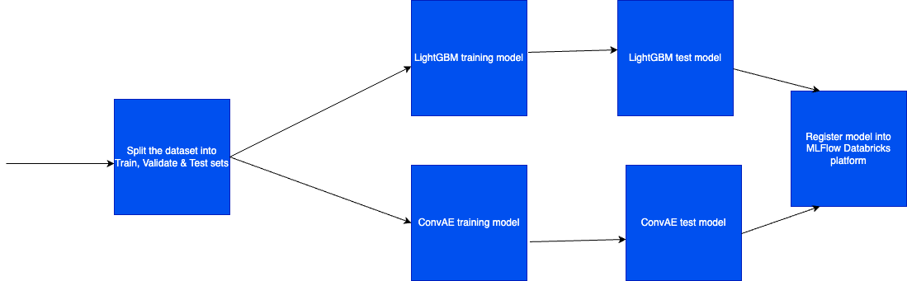
Architecture – Visualize – Train phase

Slide 22
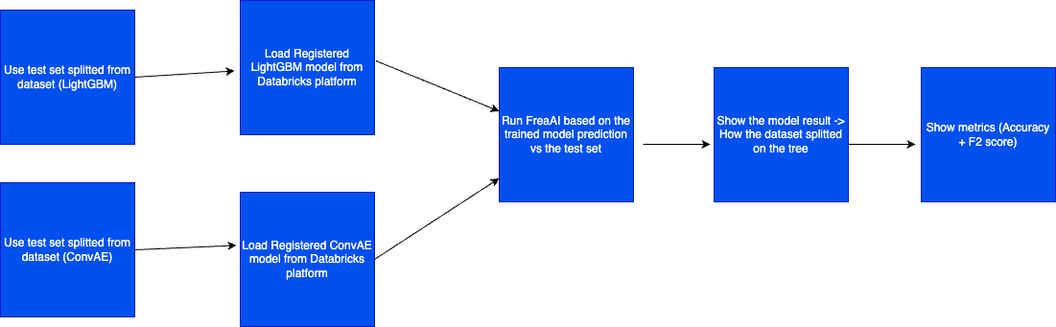
Architecture – Visualize – Test phase

Slide 23
DEMO

Slide 24
THE report

Slide 25
LightGBM model Top under-performing single features
By accuracy:
By F2:
Feature | Leaf id | F2 | F2 improvement | Precision | Recall | Size | Feature Min | Feature Max
Flow_max | 3 | 0.21023766 | 0.106485577 | 1 | 0.175572519 | 19.36008677 | 0.485899448 | 0.771553427
Flow_mean | 11 | 0 | 0.067854194 | 0 | 0 | 17.78741866 | 0.587693065 | 0.752080858
A1_max | 11 | 0.531914894 | 0.066775792 | 1 | 0.476190476 | 17.89587852 | 0.712257057 | 0.895799369
Feature | Leaf id | F2 | F2 improvement | Precision | Recall | Size | Feature Min | Feature Max
A1_mean | 12 | 0.48 | 0.056052405 | 1 | 0.424778761 | 14.04555315 | 0.609992176 | 0.817405879
A1_min | 9 | 0.559440559 | 0.051775773 | 1 | 0.503937008 | 14.42516269 | 0.505282819 | 0.772128463
Flow_max | 15 | 0 | 0.047679034 | 0 | 0 | 11.55097614 | 0.674449623 | 0.760386884

Slide 26
LightGBM model Top under-performing pairs of features
By accuracy:
By F2:
Feature | Leaf id | F2 | F2 improvement | Precision | Recall | Size | Feature 1 Min | Feature 1 Max | Feature 2 Min | Feature 2 Max
A2_min-Flow_min | 8 | 0 | 0.134154319 | 0 | 0 | 19.30585683 | -1.094181836 | 0.118916146 | 0.218962058 | 0.734922409
Ther_min-Flow_mean | 5 | 0.086372361 | 0.119862232 | 1 | 0.0703125 | 18.65509761 | -1.913559854 | inf | 0.355449021 | 0.752080858
A2_min-Flow_mean | 9 | 0.050301811 | 0.118831397 | 1 | 0.040650407 | 18.92624729 | -1.094181836 | inf | 0.355449021 | 0.752080858
Feature | Leaf id | F2 | F2 improvement | Precision | Recall | Size | Feature 1 Min | Feature 1 Max | Feature 2 Min | Feature 2 Max
A2_mean-Temp_max | 12 | 0.435139573 | 0.078905549 | 1 | 0.381294964 | 19.57700651 | -0.936725825 | 0.206062786 | -1.507191718 | -1.051625073
A1_mean-Cur_mean | 10 | 0.49689441 | 0.072045884 | 1 | 0.44137931 | 17.02819957 | 0.580596834 | 0.942281395 | -0.188461393 | -0.022254567
A1_max-Cur_mean | 9 | 0.421245421 | 0.071682102 | 1 | 0.368 | 17.13665944 | 0.693404496 | 0.895799369 | -1000 | -0.022254567

Slide 27
ConvAE model Top under-performing single features
By accuracy:
By F2:
Feature | Leaf id | F2 | F2 improvement | Precision | Recall | Size | Feature Min | Feature Max
Volume Flow RateRMS | 4 | 0.364727608 | 0.090140611 | 1 | 0.314741036 | 13.99108138 | -4.238382816 | -1.515254796
Temperature | 16 | 0 | 0.072819231 | 0 | 0 | 13.21070234 | -0.759024441 | -0.65916568
Accelerometer1RMS | 19 | 0.229257642 | 0.049144344 | 0.233333333 | 0.22826087 | 16.49944259 | 0.275259927 | 0.394063577
Feature | Leaf id | F2 | F2 improvement | Precision | Recall | Size | Feature Min | Feature Max
Volume Flow RateRMS | 4 | 0.364727608 | 0.090140611 | 1 | 0.314741036 | 13.99108138 | -4.238382816 | -1.515254796
Accelerometer2RMS | 7 | 0.24534687 | 0.063093241 | 0.568627451 | 0.214814815 | 17.83723523 | -0.411027819 | -0.298931405
Temperature | 29 | 0 | 0.0607177 | 0 | 0 | 15.10590858 | -0.585140437 | -0.520010054

Slide 28
ConvAE model Top under-performing pairs of features
By accuracy:
By F2:
Feature | Leaf id | F2 | F2 improvement | Precision | Recall | Size | Feature 1 Min | Feature 1 Max | Feature 2 Min | Feature 2 Max
Accelerometer1RMS-Volume Flow RateRMS | 10 | 0.249233129 | 0.175147328 | 0.706521739 | 0.214521452 | 18.78483835 | -0.213960193 | 0.499982685 | -4.238382816 | 0.46728906
Thermocouple-Volume Flow RateRMS | 22 | 0.346534653 | 0.143449332 | 1 | 0.29787234 | 18.33890747 | -1.169565737 | inf | -1000 | 0.479849249
Temperature-Volume Flow RateRMS | 6 | 0.032552083 | 0.138352342 | 0.15625 | 0.027173913 | 12.1516165 | -1.266741037 | -0.61107254 | -4.238382816 | 0.46728906
Feature | Leaf id | F2 | F2 improvement | Precision | Recall | Size | Feature 1 Min | Feature 1 Max | Feature 2 Min | Feature 2 Max
Temperature-Volume Flow RateRMS | 11 | 0.234297109 | 0.12596773 | 1 | 0.19665272 | 13.32218506 | -1.238379657 | inf | -4.238382816 | -1.506777167
Thermocouple-Volume Flow RateRMS | 8 | 0.350669819 | 0.119735151 | 1 | 0.301694915 | 16.44370123 | -1.169565737 | -1.083770454 | -4.238382816 | -0.072681308
Accelerometer2RMS-Volume Flow RateRMS | 5 | 0.290456432 | 0.101191498 | 1 | 0.246696035 | 12.65328874 | -1000 | 0.36477688 | -4.238382816 | -1.515254796

Slide 29
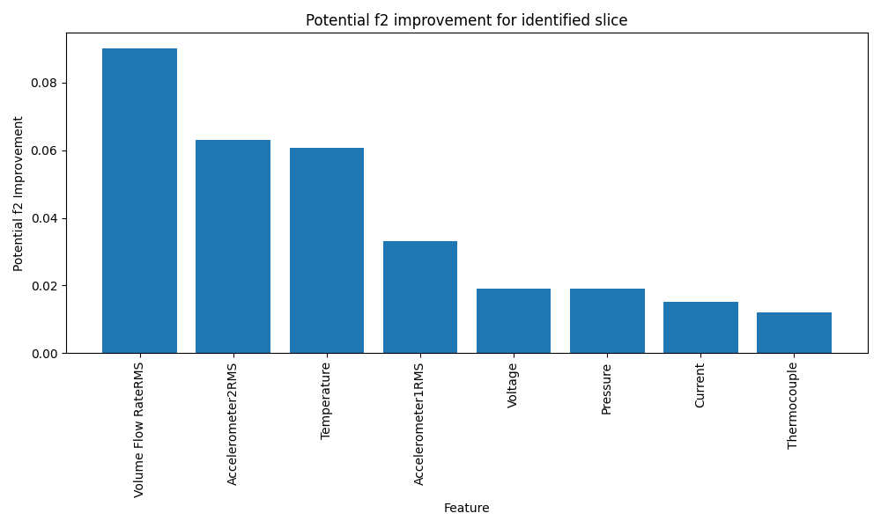
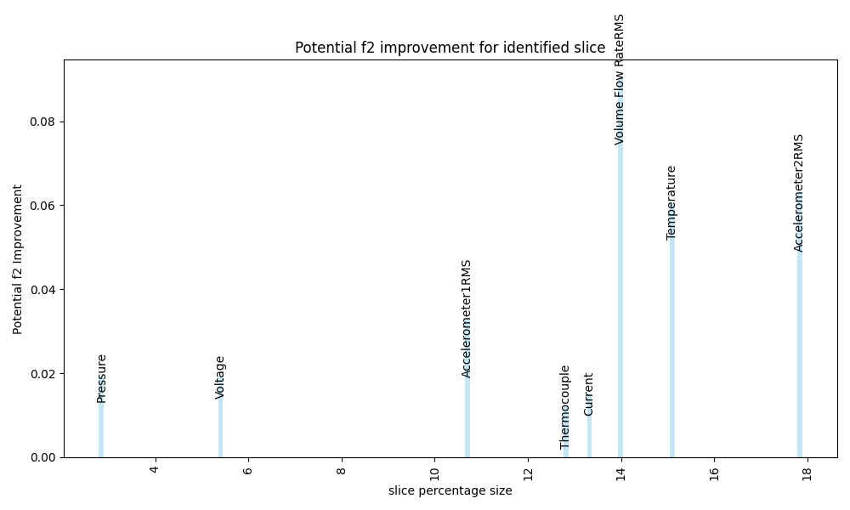
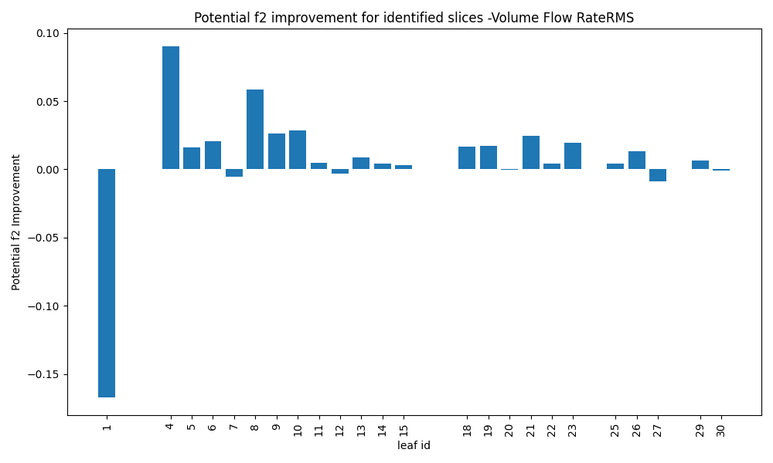
Summary and notes

Slide 30
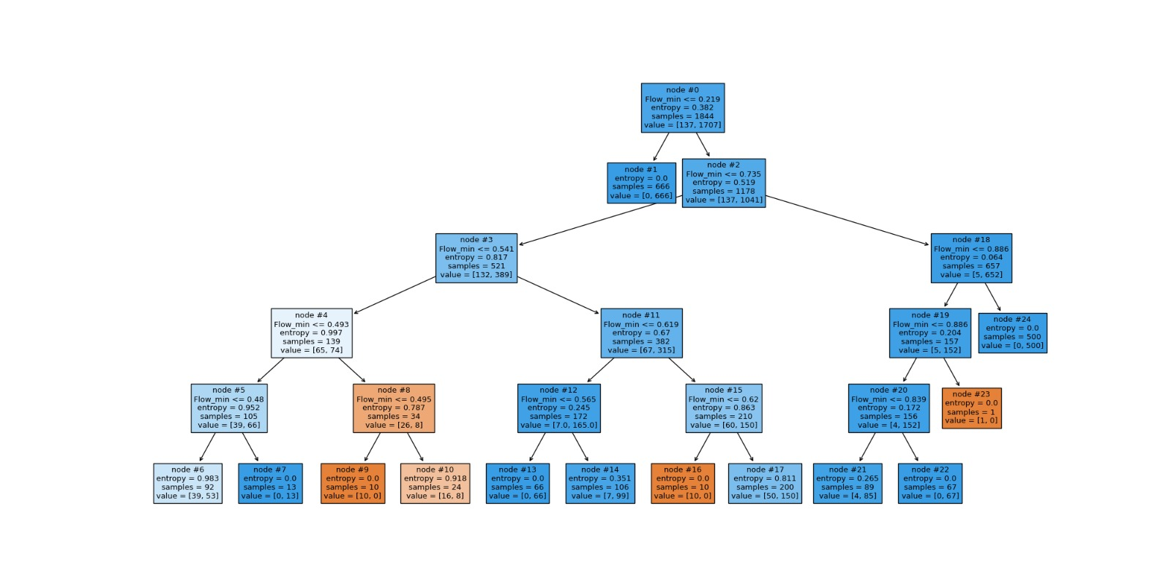
Summary and notes
Does our modification helps?
The potential improvement we got using our modification is less than original FreaAI
The modified decision tree splits better
Number of samples per node is large and therefore many nodes were dropped
Original tree
Modified tree

Slide 31
Summary and notes
Consider again nodes’ filtering heuristic.
Is a large data slice for improvement is as good input to phase 2?
Features combination finds slices which their improvement can contributes more to the overall F2.
Does improving multiple feature slice in possible?
Identifying bad slices in anomaly detection problem is difficult.
MLOps is a cycle. We tried to implement specific phase in the cycle without knowing how it will affect the next phases. Feedbacks from phase 2 can help us improve the recommendations we give in phase 1.

Slide 32

SUGGESTED PHASE 2

Slide 33
Suggested next steps
Improve models’ F2, addressing top data slices recommended by Phase 1 report.
For each data slice:
Additionally train the model on a subset of original train set, specified by a data slice.
For even more F2 improvement: Augment train data by generation of additional synthetic data, specified by a data slice.
Notes:
Use correlation matrix

Slide 34

Q&A

